Slide 1
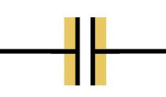
Capacitor:
Device for storing electrical energy which can then be released in a controlled manner.
Consists of two conductors, carrying charges of q and –q, that are separated, usually by a non conducting material - an insulator
Symbol in circuits is

Slide 2
Capacitance:
Capacitance is a measure of a capacitor’s ability to store charge on its plates.
The capacitance is defined to be the ratio of the amount of charge that is on the capacitor to the potential difference between the plates at this point.
Units are:

Slide 3

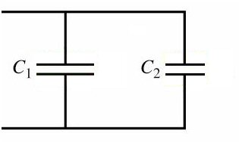
Series & Parallel Capacitors
Sometimes in order to obtain needed values of
capacitance, capacitors are combined in either
Series
or
or
Parallel
or

Slide 4
Current:
“Electric current is the rate that electric charge passes a point”, so
Current = or I = q/t
Charge
time
“The direction of current is the direction that positive charges would move, even if the actual charge carriers are negative”.

Slide 5
The SI unit of current is Ampere (A).
1 ampere = 1coulomb/second
Direct Current
If the voltage is maintained between two points in a circuit, charge will flow in one direction - from high to low potential. This is called direct current (DC)
Battery-powered circuits are dc circuits.

Slide 6
RC Circuit:
Charge and Current During the Charging of a Capacitor.
RC-Circuit: Resistance R and capacitance C in series with a source of e.m.f (V).
a
R
a
R
b
b
+
+
+
+
V
C
V
i
C
-
-
-
-

Slide 7
Instantaneous charge q on a charging capacitor:
At time t = 0: q = CV(1 - 1); q = 0
At time t = ∞: q = CV(1 - 0); q_{max} = CV
The charge q rises from zero initially to its maximum value q_{max} = CV

Slide 8
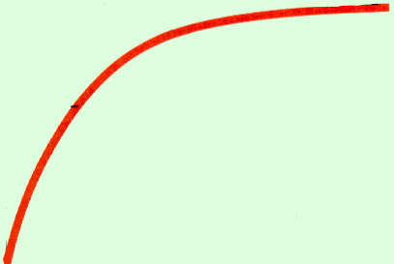
The time τ = RC is known as the time constant.
q
Capacitor
In one time constant the charge rises to 63% of its maximum value (CV).
Q_{max}
0.63 Q
Rise in Charge
τ
Time, t

Slide 9
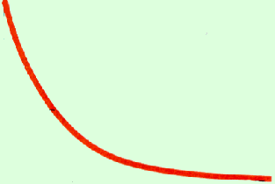
As charge q rises, the current i will decay.
i
Capacitor
I
Current Decay
0.37 I
The current is a maximum of I = V/R when t = 0.
τ
Time, t

Slide 10
The current is zero when t = ∞ (because the back emf from C is equal to V).
q
Capacitor
i
Capacitor
Q_{max}
I
0.63 I
Rise in Charge
Current Decay
0.37 I
τ
Time, t
τ
Time, t
In a time τ of one time constant, the charge q rises to 63% of its maximum, while the current i decays to 37% of its maximum value.

Slide 11
Discharging of Capacitor.
After C is fully charged, we turn switch to b, allowing it to discharge.
a
R
a
R
b
+
+
b
+
+
V
C
V
i
C
-
-
-
-

Slide 12
Instantaneous charge q on discharging capacitor:
Current i for a discharging capacitor.
v_{c}
12
V_{R}
0
0
-12
Time, t
Time, t

